Slide 1

Forest Plot in Metaanalysis
Dr. Sajal Kakkar
MD, FUICC (USA), FAROI (France)
Principal Consultant Radiation Oncology
Max SuperSpeciality Hospital, Mohali

Slide 2
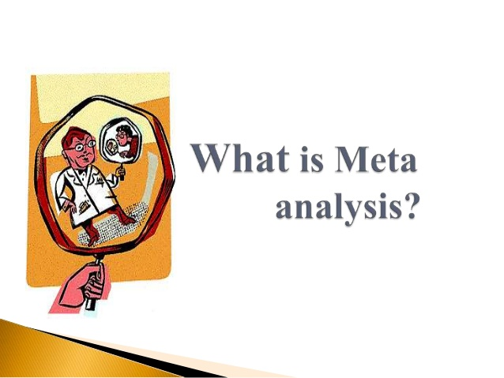
A way to calculate an average
Estimates an ‘average’ or ‘common’ effect
Improves the precision of an estimate by using all available data

Slide 3

Why Metaanalysis..
Analysis of analyses
More reliable information
Precision in estimating effects
Garbage in garbage out
File drawer effect

Slide 4

How to plan metaanalysis
Determine the research question
Identification of relevant studies
Select the studies
Data extraction
Data analysis
Examine heterogeneity/publication bias
Interpretation & Reporting

Slide 5
Data Analysis
Effect Measures
  Relative Risk/Risk Ratio (RR)
  Odds Ratio (OR)
  Hazard Ratio (HR)

Slide 6
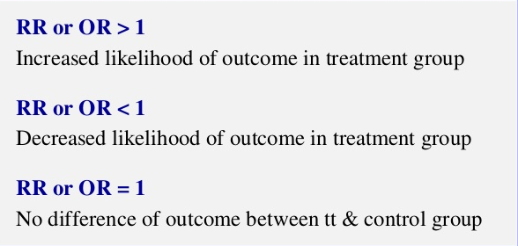
Interpretation of RR and OR
OR or RR should be accompanied by CI

Slide 7
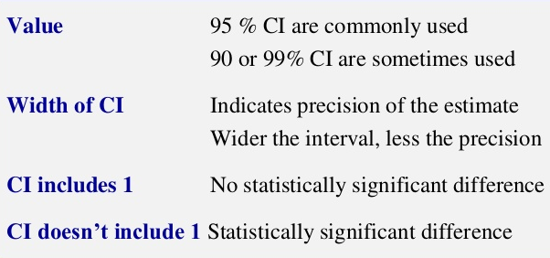
Confidence Intervals

Slide 8
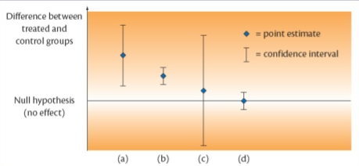
Statistical Significance and CI
Statistically significant, low precision
Statistically significant, high precision
Not statistically significant, low precision
Not statistically significant, high precision

Slide 9
The graph displaying results of metaanalysis
“Forest Plot”

Slide 10
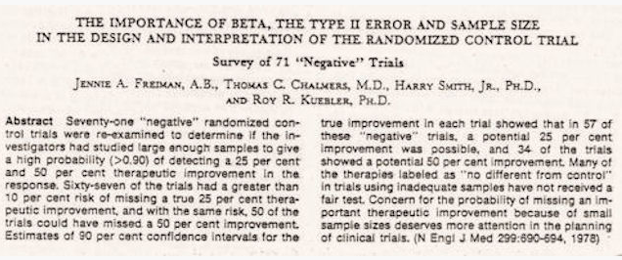
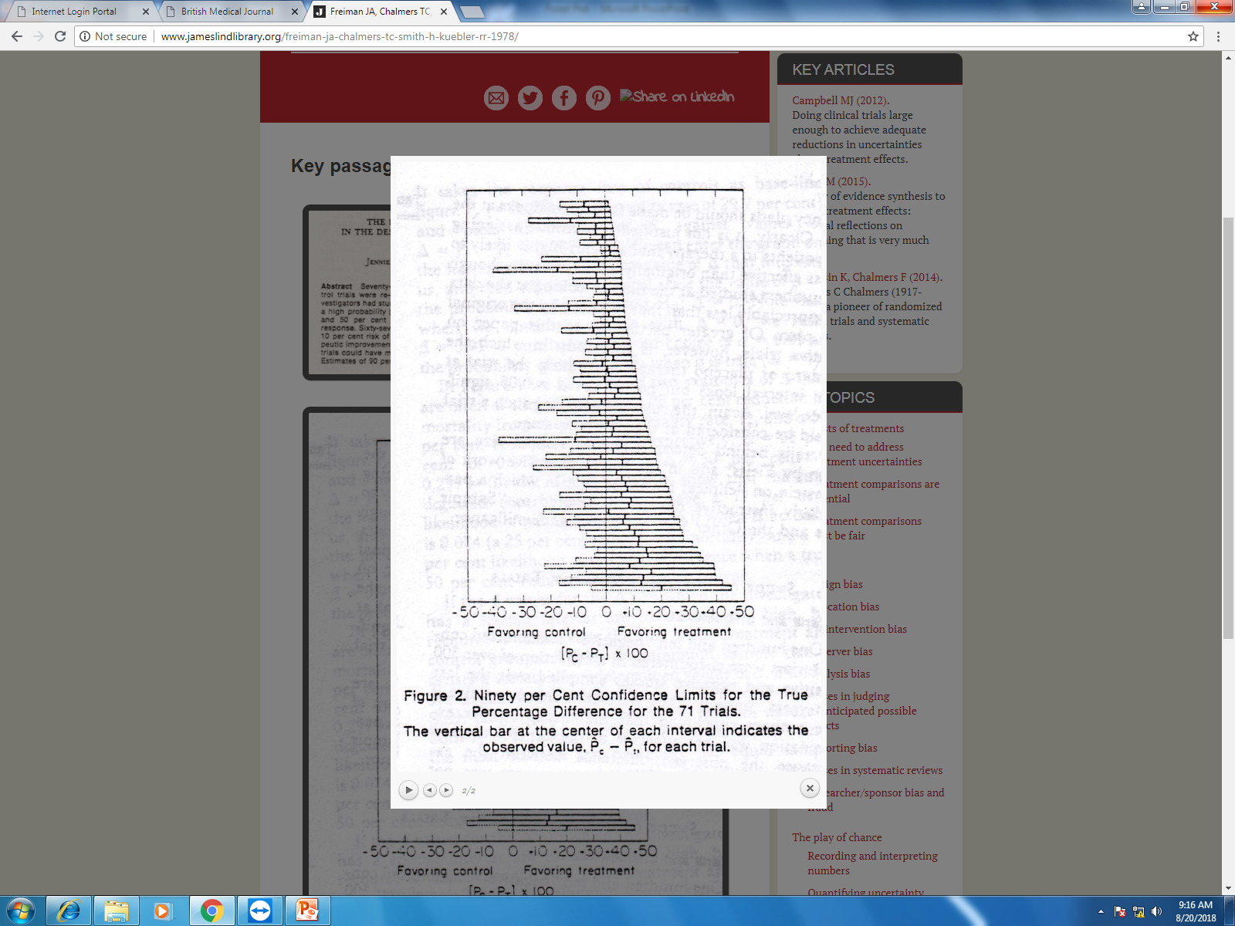
Freiman JA et al, NEJM 1978

Slide 11
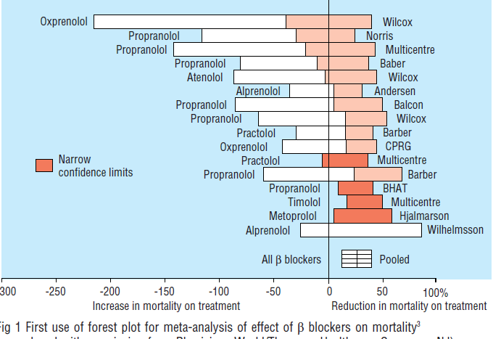
Lewis JA et al, Prim Cardiol 1982

Slide 12

Forest Plot or Forrest Plot!!

Slide 13
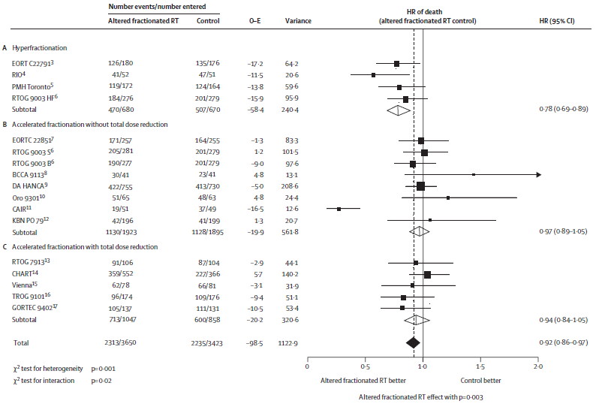
Forest Plot of a metaanalysis
Bourhis J et al, Lancet 2006

Slide 14
How to read a forest plot
The Axis
Line of Null Effect
Horizontal Axis
.5
.2
1
2
5
Scale for statistic being displayed
(OR or RR)

Slide 15
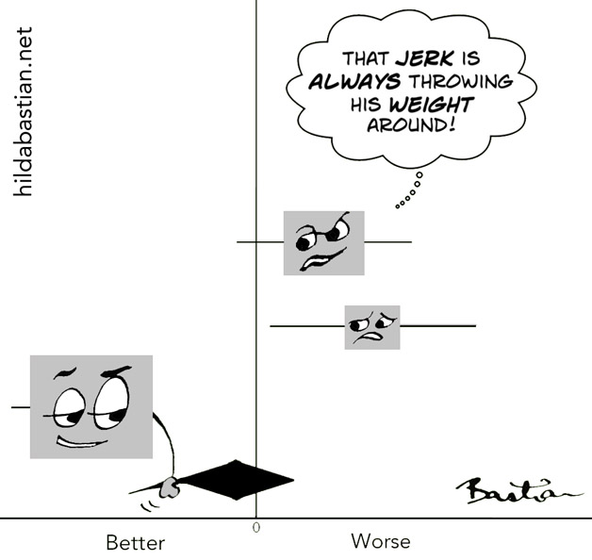

Slide 16
Study Lines
Weight of each trial in MA
95% confidence interval
of the study
.5
.2
1
2
5
Favors Treatment
Favors Control

Slide 17
Combining all the studies
CI
Diamond of the bunch
.5
.2
1
2
5
Favors Treatment
Favors Control

Slide 18
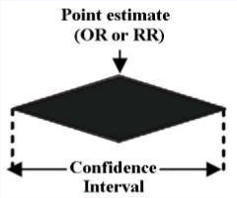
The Diamond
Shows combined point estimate (OR or RR)
& CI for the metaanalysis

Slide 19
Column1
Study/Author name
Year of publication
Column 2
No.of pts with events in the group
Total pts in the same group
Column 3
Observed – Expected
Variance
Column 4
Forest plot in nos.

Slide 20
Row 1
Statistics of diamond
Row 2
Heterogeneity stats

Slide 21
Heterogeneity..
variation between the studies’ results
Differences between studies with respect to:
Patients: diagnosis, in- and exclusion criteria, etc.
Interventions: type, dose, duration, etc.
Outcomes: type, scale, cut-off points, duration of follow-up, etc.
Quality and methodology: randomised or not, allocation concealment, blinding, etc.

Slide 22
Heterogeneity
Often statistically checked using x² test
  not sensitive
  p<0.1 implies heterogeneity
I² test newer method for evaluating
Located at bottom of the plot
Should be <50%

Slide 23
Exercise 1

Slide 24


Slide 25

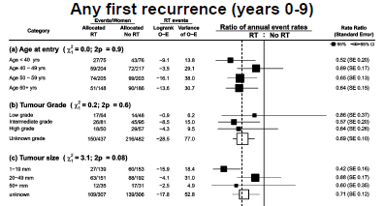
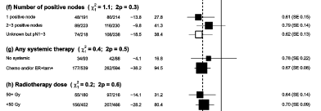

Study label
Descriptor
No.of events
Total women
Treatment effect
No effect
Scale measuring treatment effect
Read labels carefully
Heterogeneity

Slide 26

Large study group, narrow confidence interval, entirely to left; suggests that the intervention works
Larger study group, narrow confidence interval, crossing midline; suggests that the intervention doesn’t work
Probably a small study group, with a wide confidence interval, crossing the line of no effect; unable to say if the intervention works

Slide 27
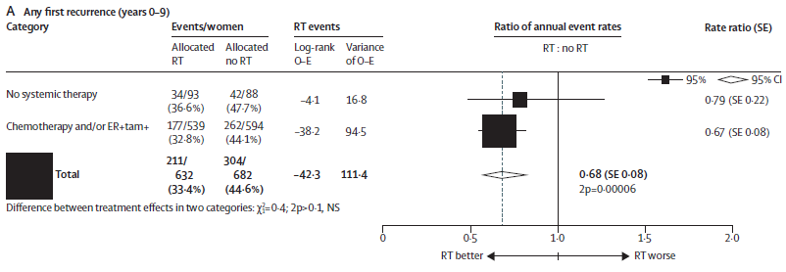
Probably a small study group, with a wide confidence interval, crossing
the line of no effect
Larger study group, narrow confidence interval, entirely to left;
suggests that the intervention works
Metaanalysis of all groups, suggests that the intervention works

Slide 28
Pooled estimate is marked with an
unfilled diamond with an ascending
dotted line
Confidence Interval

Slide 29
Exercise 2

Slide 30
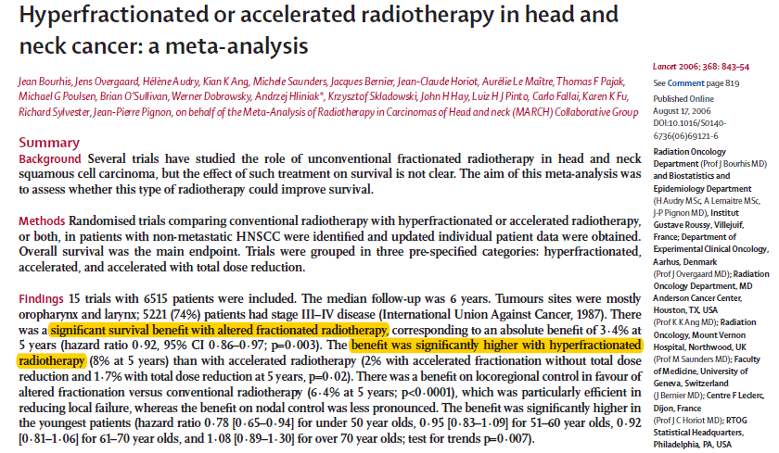
MARCH Collaborative Group, Lancet 2006

Slide 31

Exercise 3
Cochrane Collaboration Logo

Slide 32
Some other plots..

Slide 33
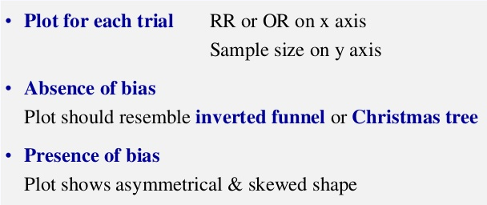
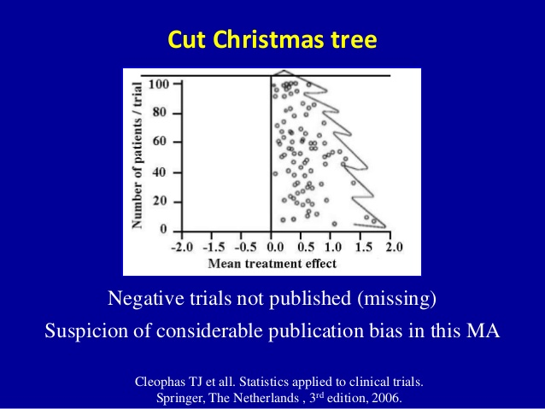
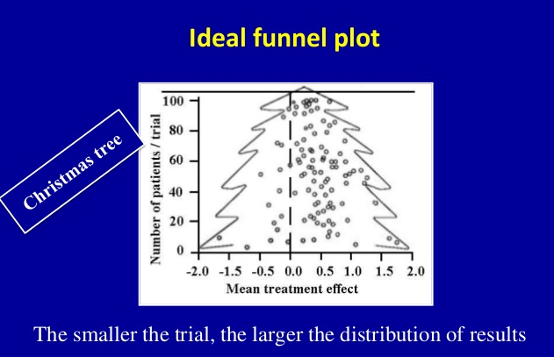
Funnel plots
Bias detected by simple graphical test

Slide 34
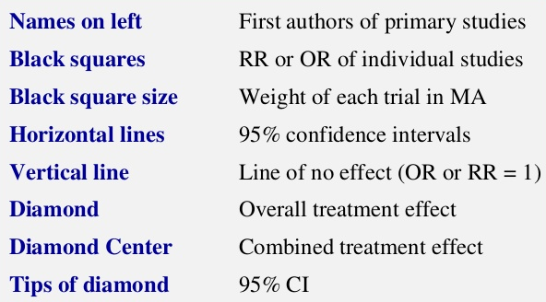
Summarize..
Interpretation of Forest Plot

Slide 35
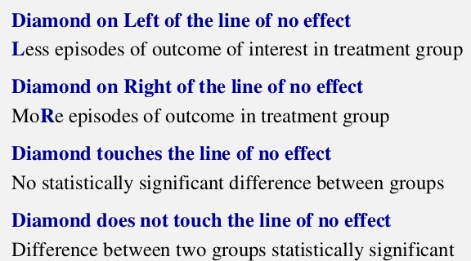
Diamond in Metaanalysis

Slide 36
Thank You

