Slide 1
HPV and anogenital cancers
Abraham Peedicayil
Dept of Gynaecologic Oncology
CMC, Vellore

Slide 2
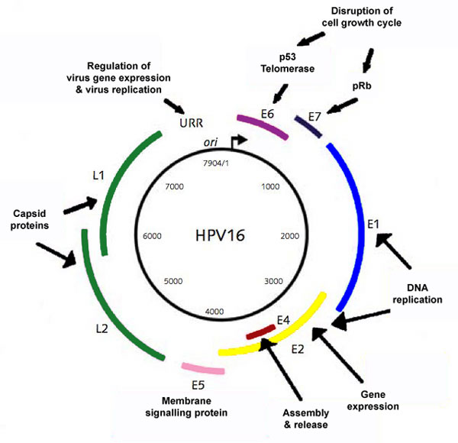
The Virus
Small non-enveloped ds DNA virus ≈ 8000bp
Epitheliotropic virus
classified based on:
- tropism for mucosal or
cutaneous surfaces
- DNA sequence into five
evolutionary groups
- 15 high risk types
Notes:
The HPV virus is a non enveloped ds DNA virus. Of the numerous genotypes only about 40 infect the genital tract. There are 5 genera Alpha, beta, gamma, mu and nu of which most of the alpha papilloma viruses infect the mucosa.
Upstream regulatory region or long control region
E1-- Replication and replication repression
E2-- Activates transcription in HPV types 6, 11 and 16, represses transcription and binds to long control region.
E3-- No known product or function
E4-- Cytoplasmic protein in HPV-1-induced warts.
E5-- Transformation in HPV-6.
E6-- Transformation in cooperation with E7 in HPV-16 and HPV-18.
E7-- Transformation in cooperation with E6.
E8-- No known product or function.
L1-- Major capsid protein.
L2-- Minor capsid protein.
2

Slide 3
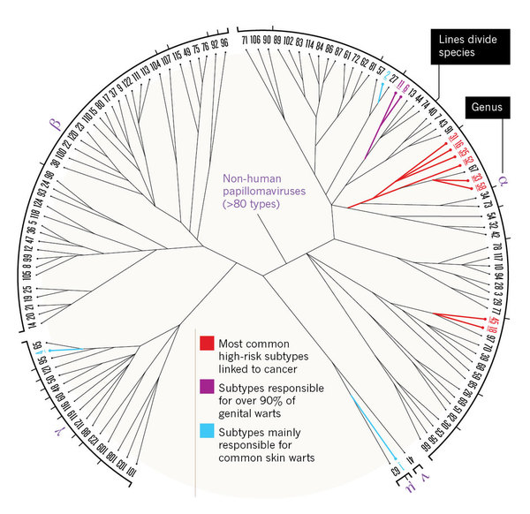
Classification of HPV genotypes

Slide 4
HPV genotypes
High risk 16, 18, 31, 33, 35, 39, 45, 51
52, 56, 58, 59, 68, 73, 82
Intermediate 26, 53, 66
Low risk 6, 11, 40, 42, 43, 44, 54, 61, 70
72, 81, CP6108
Notes:
There are 15 high risk types and a further 3 potentially oncogenic types.

Slide 5
Population at risk in India
Population of India 1.25 billion
Women > 15 yrs 430 million
Women 30 to 65 years 230 million

Slide 6
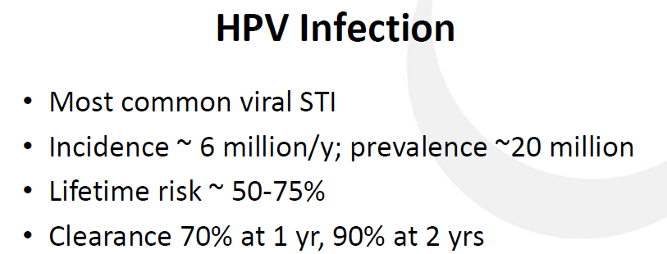
Epidemiology of HPV infection

Slide 7
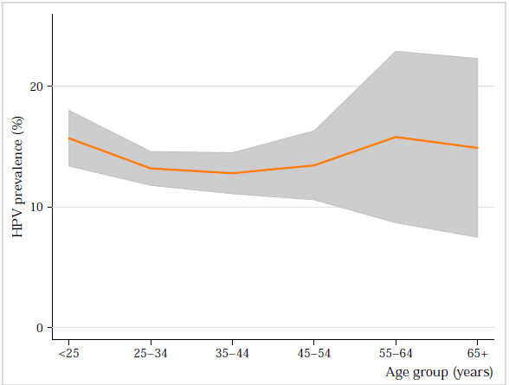
Crude age specific prevalence of HPV

Slide 8
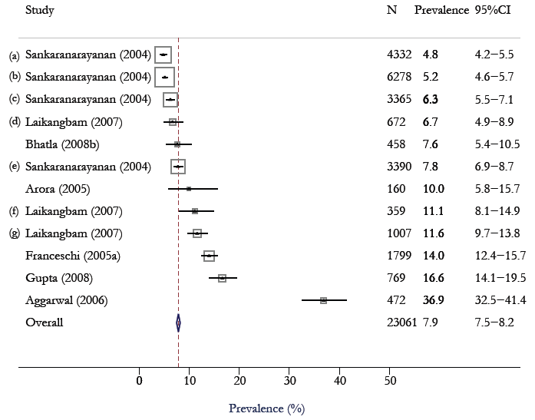
HPV Prevalence in women with normal cytology

Slide 9
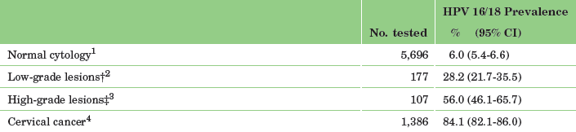
Prevalence of HPV 16 & 18 in Indian women

Slide 10
Prevalence of HPV in Cervix and Vagina in the community (n=809)
Cervix Vagina
Any HPV type 76 9.4 % 70 8.7 %
Low Risk HPV types 25 3.1 % 22 2.7 %
Probable High Risk 5 0.6 % 7 0.9 %
High Risk HPV types 47 5.8 % 39 4.8 %
Multiple infections 15 1.9 % 11 1.4 %
Peedicayil et al
Notes:
Mittal et al in WB, found hrHPV in 4.7% of >44000 women screened by HC2 and CIN3 in 3.9/1000 women.

Slide 11
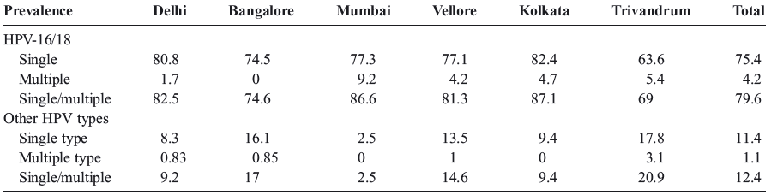
HPV prevalence in cervical cancer n=667
Pillai et al, 2010 Int J Gyn Cancer
Any hr-HPV type 92.1 %
Any single hr-HPV type 86.8 %
Any multiple hr-HPV type 5.3 %

Slide 12
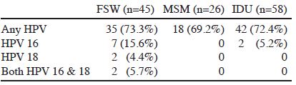
HPV infection in high risk groups
Ghosh et al , 2012
Asian Pacific J Cancer Prevenion

Slide 13
Prevalence of HPV is related to sex
100
90
80
70
60
50
40
30
20
10
Sex Transm Infect 2000, 76: 58
Sex Transm Dis 2000, 27: 438-45
Sex workers
HPV %
STD women
General population
20 25 30 35 40 45 50
Age
Notes:
Since HPV is a sexually transmitted infection, it is found more commonly in sex workers, STD clinic attendees, incarcerated persons and sexually promiscuous people as compared to the general population.

Slide 14
HPV genotypes in Indian women with HIV
Percentage having high risk HPV | Non HPV-16/HPV -18 | Multiple infection | Risk factors for high risk HPV | Study site Reference
37.3% | 25% | 18.6% | Early age of coitus | Vellore Peedicayil et al. Journal of Lower Genital Tract Disease 2009;13:159-64
35.3% | 30% | 27.8% | ≥ 2 lifetime partners (ii) ↓ CD4 count | Pune Mane et al. PLoS ONE 2012;7:e38731
46.2% | 53% | 17% | HIV infecton was strong predictor as compared to HIV negative | West Bengal Sarkar et al. BMC Infectious Diseases 2011;11:72
Notes:
Sarkar et al: HIV pts. 5 times more at risk of acquiring oncogenic HPV after adjusting for age and duration of sexual activity

Slide 15
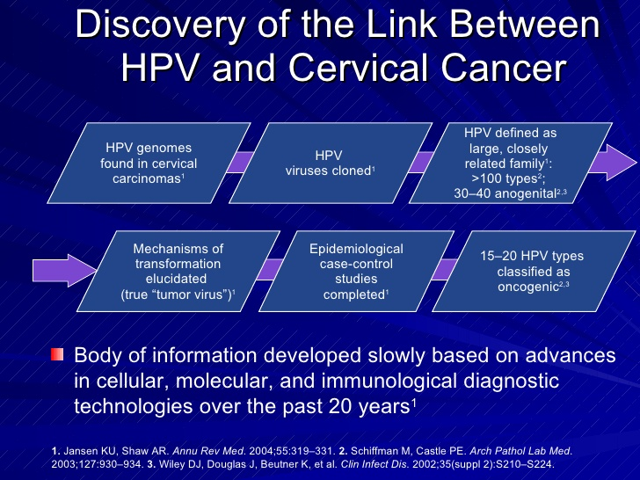

Slide 16
HPV type specific odds ratios for cervical cancer
16
18
45
31
52
16, 18
6
11
0.1 0.5 1.0 5 10 100 500 1000
Odds ratio with 95% confidence intervals
NEJM 2003, 348: 518-27
Notes:
The strength of association between the hr-HPV types and cervical cancer are extremely high with odds ratios over 100

Slide 17
The phases of the cell cycle
Spindle assembly check point
M
G2/M check point
G1
G2
G1/S check point
S
The virus inhibits tumour suppressor genes and
sneaks past cell cycle check points.
Notes:
The virus deregulates the cell cycle control mechanisms by suppressing the tumour suppressor genes. Thus the virus sneaks past the various check points.

Slide 18
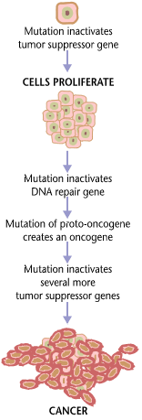
Steps in carcinogenesis
binds
P 53
E 6
Apoptosis
G1 arrest
DNA repair
E 7
G 1
binds
Alteration of cell cycle pathways
E 2 F-1
M
S
pRb
G 2
Genomic Instability
Cell proliferation
Cancerous cell

Slide 19
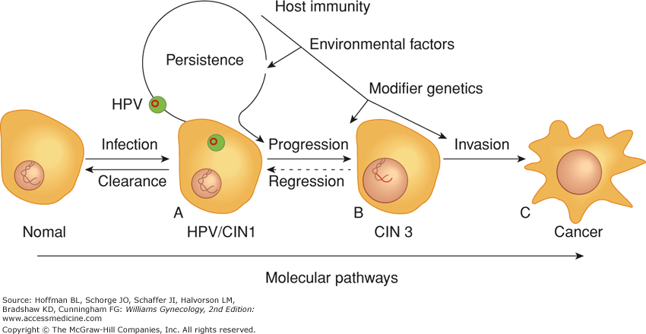
Malignant transformation due to HPV

Slide 20
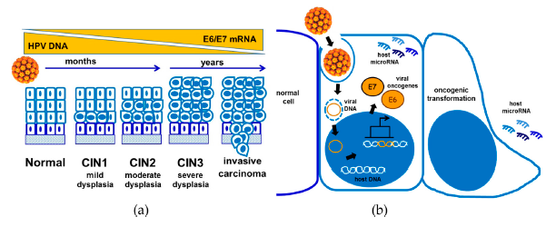
Progression to cervical cancer

Slide 21
Cervical cancers attributed to specific HPV genotypes
16
18
45
31
33
52
58
35
Others
None
53.5 %
70.7
77.4
80.3
82.9
85.2
87.4
88.8
95.6
100 %
251,199
80,859
31,549
13,678
12,134
10,929
10,242
6,570
31,793
20,769
0 20 40 60 80 100
469,723 / yr
Notes:
This slide shows he number of cancers attributed a specific genotype and the cumulative %. 16 and 18 account for 70.7 %. A pentavalent vaccine would prevent 82.9 % of cervical cancers.

Slide 22
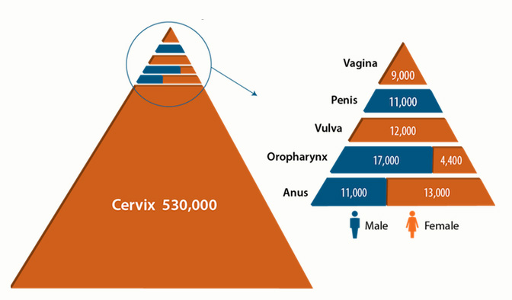
Worldwide burden of HPV related cancers

Slide 23
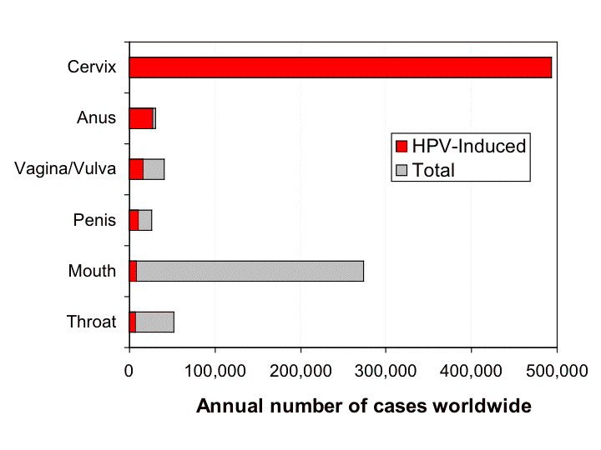
HPV related cancers

Slide 24
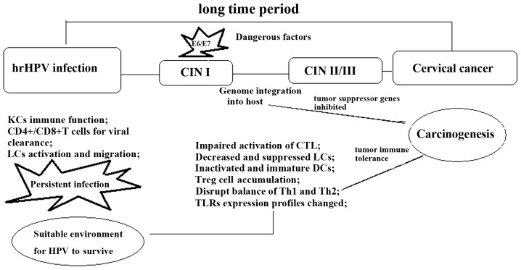

Immune modification and lesion progression
Song et al 2015 Oncol Lett 2015; 10: 600-6

Slide 25
HPV induced processes
Infection Deregulation of cell cycle control mechanisms
Cellular proliferation
Integration Chromosomal instability
Cellular transformation
Immortalization
Notes:
The virus can deregulate the cell control mechanisms in its episomal form but does its real damage by integrating with the host genome. Chromosomal instability leads to mutations that result in transformation and immortalisation.

Slide 26
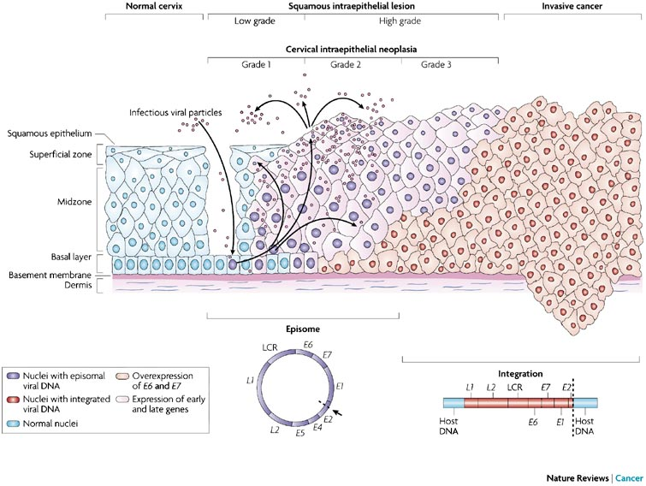
HPV infection
Notes:
HPV gains access to the basal layer through breaches in the squamous epithelium. It divides within the cells as it matures and finds its way to the surface where the virus is shed to infect other hosts. Episomal DNA is shown in violet and the integrated viral DNA in red.

Slide 27
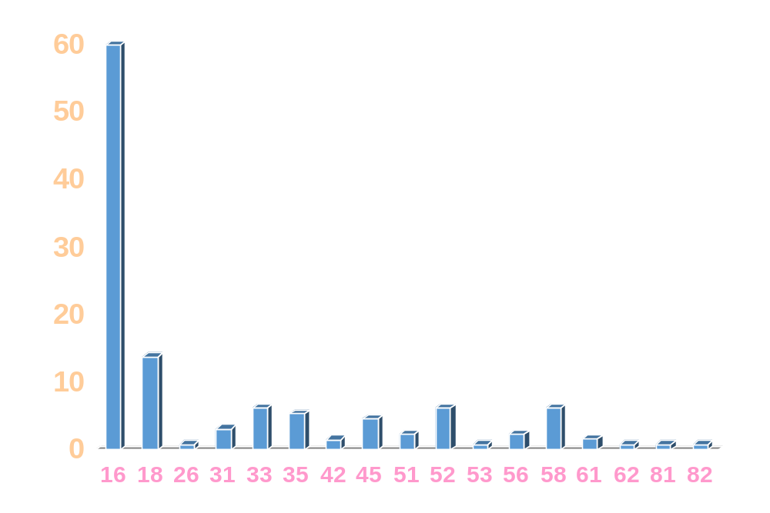
HPV genotypes in cervical cancer n = 130
%
HPV type
Peedicayil et al, Int J Gynec Cancer, 2006
Notes:
We looked at HPV in cervical tissue from patients with CIN and cancer and found type 16 in 60 % and type 18 in 14 %. 33, 35, 45, 52 and 58 were also frequent.

Slide 28
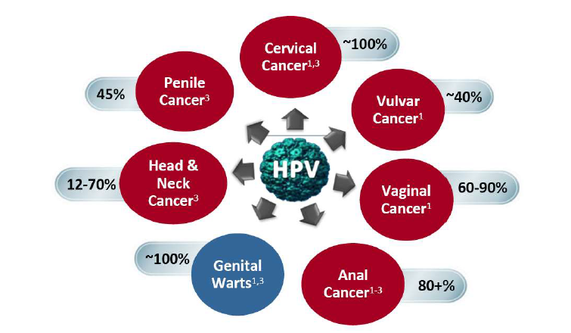
HPV causes more than cervical cancer
VIN 80 % VAIN 90 % CIN 70 % AIN 90 %
Notes:
HPV causes several anogenital precancers and invasive cancers. The proportions attributable to HPV are also shown.

Slide 29
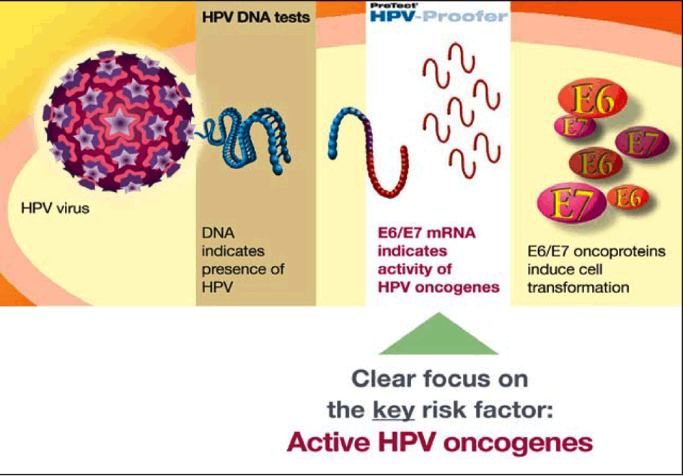
Outline of diagnostic approach
Evolution of diagnostic approaches

Slide 30
Roles of HPV testing
Primary screening for cervical precancer
HPV epidemiology
Triaging of borderline screening tests (Pap / VIA)
Test of cure after treatment of cervical
pre-cancer & cancer
Differentiating endocervical from endometrial cancer

Slide 31
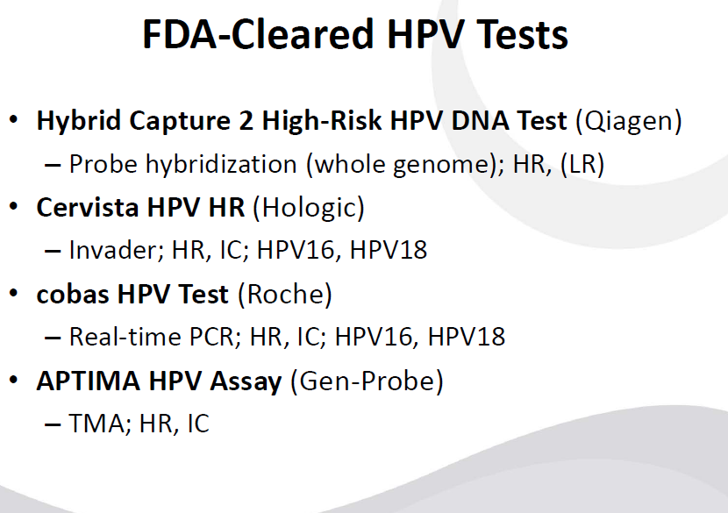
. Onclarity (Beckton Dickinson)

